Slide 1
Marketing Hospice to ACOs Strategies for Hospice Leaders
Sue Lyn Schramm, MA
Schramm Consulting, LLC

Slide 2
Session Objectives
Prioritize your strategic plan to take advantage of business opportunities with ACOs
Know how to make the case to ACO leaders why hospice should be included in their network
Identify the best potential business partners for your organization in your market

Slide 3
Why Should Hospices Care about ACOs and Other Advanced Payment Models?

Slide 4
Number of Medicare Certified Hospices
Source: “Hospice Services: Assessing Payment Adequacy and Updating Payments,” from Report to the Congress: Medicare Payment Policy, MedPAC (Medicare Payment Advisory Commission), Washington, DC, March 2019, p.318.

Slide 5
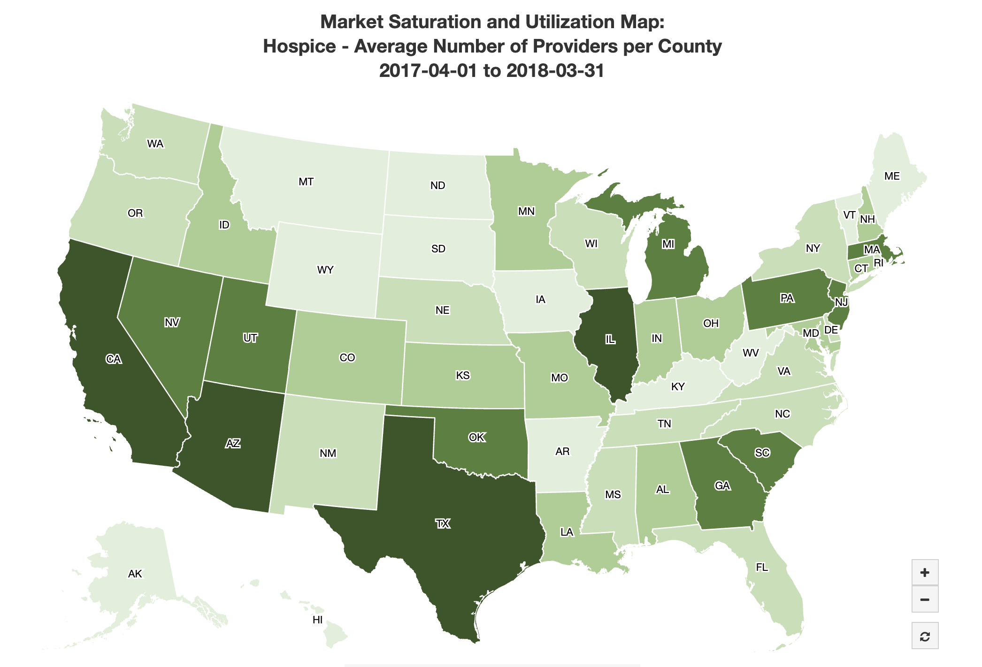
Hospice Providers are Facing More Competitors than Ever Before in Many State
Density of Competition in Hospice Care
Density Quartiles:
Source: Center for Medicare and Medicaid Services (CMS), https://data.cms.gov/market-saturation, accessed April 9, 2019.

Slide 6
So What’s Next for Hospice & Palliative Care Providers?
Adjust to flattened prospects for growth as competition heats up
Fight for share of patients with both hospice and non-hospice providers
OR
look for opportunities to partner with other parts of the healthcare continuum in new ways
Take advantage of our skills in managing frail patients in the community

Slide 7
Opportunities for Hospice and Palliative Providers
Understanding What ACO and APM Partners Want, and Why They Need You!

Slide 8
Why Good Hospice and Palliative Care is Important for ACOs
ACOs are evaluated by CMS-set benchmarks for the total cost of care –
including hospice and end of life care
In addition, hospice and palliative care can help ACOs reduce costs in some of their highest-priority spending areas

Slide 9
Movement Towards Risk for ACOs Creates More Opportunity for Hospice & Palliative Care
Hospice is already experienced at managing risk
Medicare Hospice Benefit is one of the original experiments in fixed per diem payments
Hospice and Palliative Care can help reduce total cost of care for ACOs
Reduce hospital readmissions
Keep patients out of expensive hospital settings
Even Hospice GIP care is much lower cost than hospital daily cost
Palliative care can help manage chronically ill patients in their communities

Slide 10
U.S. Hospice Volumes Are Increasing As Americans Age and Increase Acceptance of Hospice
Source: “Hospice Services: Assessing Payment Adequacy and Updating Payments,” from Report to the Congress: Medicare Payment Policy, MedPAC (Medicare Payment Advisory Commission), Washington, DC, March 2019, p.319.

Slide 11
Baby Boomers Are Just Beginning Old Age
Source: Philip N. Cohen, “2016 U.S. population pyramid, with Baby Boom,” from the blog “Family Inequality” using U.S. Census Bureau 2016 data; accessed at https://familyinequality.wordpress.com/2017/06/03/2016-u-s-population-pyramid-with-baby-boom/ on March 31, 2019.

Slide 12
Top Focus Areas for ACOs
Objective | Percent of ACOs with Objective
Prevent hospital readmissions | 58%
Manage chronic conditions | 56%
Prevent ED visit and inpatient admissions | 54%
Integrate post-acute care | 35%
Integrate mental health care | 18%
Improve end-of-life care assessment | 16%
Improve pharmacy or medication adherence | 14%
Improve patient engagement | 12%
Provide palliative care | 11%
Avoid overuse of specialty care/redundant imaging & diagnostics | 10%
Source: “The 2017 ACO Survey,” HealthAffairs Blog, October 4, 2017, http://healthaffairs.org/blog/2017/10/04/the-2017-aco-survey-what-do-current-trends-tell-us-about-the-future-of-accountable-care/. Accessed October 25, 2017.

Slide 13
Hospital Costs are Biggest $ Target for ACOs
Sources: ACU per diem: Kaiser Family Foundation State Health Facts; ICU per diem: JPM, Vol. 19, No. 11, 2016; ED median cost per visit: “Patient Charges for Top Ten Diagnoses in the Emergency Room,” PLOS One, Vol. 8, No. 2, February 2013.

Slide 14
Result: Hospice Referral Sources Must Pay Much More Attention to Post-Acute Care
from Hospitals and Health Networks Magazine:
“Downstream providers will have a growing effect on health systems’ reputation and bottom line.”
“Post-acute care providers…become an extension of the hospital’s care delivery model and have a much more direct impact on a hospital's reputation and bottom line than they did before.”
Source: Gordon Phillips and Michael Abrams, “Why Post-Acute Care Partners Are Critical to Hospitals’ Future,” Hospitals and Health Networks Magazine, January 2017, p. 44-45.
Notes:
Survey of 1,097 CEO members of the American College of Healthcare Executives (ACHE) and 1,444 senior provider-based members of the Society for Healthcare Strategy and Market Development.

Slide 15
The Top 5% of Patients Account for 50% of All Healthcare Spending
Source: Steven B. Cohen, Ph.D., “The Concentration of Health Care Expenditures and Related Expenses for Costly Medical Conditions, 2012,” Statistical Brief #455, AHRQ, October 2014.

Slide 16
Top Five Most Costly Medical Conditions
Heart disease
Trauma-related disorders
Cancer
Mental disorders
COPD/asthma
Source: Steven B. Cohen, Ph.D., “The Concentration of Health Care Expenditures and Related Expenses for Costly Medical Conditions, 2012,” Statistical Brief #455, AHRQ, October 2014.

Slide 17
Beyond Care of the Dying: The High-Cost Population Is Not All at End of Life
High-Cost Population
18.2 Million People
High-Cost End-of-Life Population
2 Million People
Low-Cost End-of-Life Population
0.5 Million People
Source: Dying in America: Improving Quality and Honoring Individual Preferences Near the End of Life, Institute of Medicine (IOM), The National Academies Press, Washington, DC, 2014, Appendix E, p.27.
Notes:
By High-Cost here we are referring to patients in the top 5% for health care spending.

Slide 18
Palliative Care Savings in an ACO
Mean HPBC LOS: 109 Days
Control 12-Month Spend: $60,709
HPBC 12-Month Spend: $50,274
Source: Dana Lustbader, MD, FAAHPM, et al., “The Impact of a Home-Based Palliative Care Program in an Accountable Care Organization,” Journal of Palliative Medicine, August 20, 2016. Note that Medicare Part A spending shown here includes costs from those patients referred to hospice prior to death.

Slide 19
The Unpalatable Reality
Many hospices may be ahead of ACOs in their market in understanding the incentives and how they can be good business partners to ACOs.

Slide 20
So Far, Very Few ACOs Have Focused on Hospice and Palliative Care
Why?
Study Findings: Little Change in EOL Care
No increase in use of hospice or hospice days
No change in number of transitions or days at home
Slight reduction in aggressive care at end of life (ICU use or tube placement)
Three quarters of ACOs didn’t include hospice and palliative providers in contracts
Weak incentives under Track 1 MSSP program
Conflict with hospital fee for service revenue for aggressive end-of-life care
More focus to date on higher-spend easy targets like SNF use
ACOs lack experience
Source: Lauren G. Gilstrap, et al., “Changes in End-of-Life Care in the Medicare Shared Savings Program,” Health Affairs 37:10, October 2018, p.1693.

Slide 21
Understanding 2019’s Radical Changes for Medicare ACOs
And How this Can Work for Hospice and Palliative Care Leaders

Slide 22
CMS Has Experimented with Many ACO Forms and Levels of Risk
Pioneer ACOs (Discontinued)
Next Generation ACOs (51 active participants)
Investment Model ACOs (45 active participants)
Medicare Shared Savings Program ACOs (561 participants)

Slide 23
Medicare MSSP ACOs Grew Quickly from 2012 Inception
Source: “Medicare Shared Savings Program Fast Facts,” Center for Medicare and Medicaid Services, January 2018.

Slide 24
ACO Penetration 2018 (Includes Commercial ACOs)
Percent of Population Covered by an ACO, by Hospital Referral Region, 2018
Source: Leavitt Partners’ accountable care organization database, as reported in “Recent Progress in the Value Journey: Growth of ACOs and Value-Based Payment Models in 2018,” Health Affairs Blog, David Muhlestein et al., August 14, 2018.

Slide 25
Medicare ACOs Have Been Especially Concentrated in Urban Centers
Source: “Medicare Shared Savings Program Fast Facts,” Center for Medicare and Medicaid Services, January 2018.

Slide 26
ACOs Have Earned Payouts from Medicare
Source: “Medicare Shared Savings Program Fast Facts,” Center for Medicare and Medicaid Services, January 2018.

Slide 27
But Out of 561 Medicare ACOs in the MSSP, Only a Small Minority Accepted Down-Side Risk
DISCONTINUED
Source: “Medicare Shared Savings Program Fast Facts,” Center for Medicare and Medicaid Services, January 2018.

Slide 28
Understanding Risk Terminology
Upside Risk
Provider shares in any savings, but does not lose money if targets aren’t met
Downside Risk
Provider shares in losses with CMS if targets are not met
Two-Way (Upside & Downside) Risk
Associated with greater payouts if there are savings
Risk of significant provider losses if cost-reduction efforts fail

Slide 29
New ACO Rules Are Meant to Speed the Transition to Accepting Risk
Not enough ACOs were accepting downside risk
Too many were staying in Track 1, with no risk of losses
Many Track 1 ACOs were not meeting targets, generating losses for CMS while taking advantage of waivers of some federal requirements
New structure permits only two primary ACO tracks:
BASIC: Upside risk only, but more risk phases in over time
ENHANCED: Multiple variations that include upside and downside risk
All ACOs are expected to transition to ENHANCED track over time
ACOs have 1-3 years to begin accepting downside risk

Slide 30
New ACO Rules Announced in Late December
Changes to program announced December 21, 2018
No new ACO agreements this January
Expiring agreements allowed to continue for another 6 months
New agreements under the new rules begin July 1, 2019

Slide 31
So Far, ACOs are Staying in the Program
Most ACOs expressed intent to renew this July
Therefore most will be moving towards increased risk within the next 3 years (along the BASIC glide-path)
BUT Physician-led ACOs have shown higher drop-out rates than hospital-owned ACOs

Slide 32
Assessing Possible Partners for Hospice and Palliative Providers
Choosing the ACO and APM Partners You Want to Work With

Slide 33
Two Main Types of ACO Ownership: Physician v. Hospital & Integrated System
Physician-Led ACOs Have Shown More Success in Many Areas for Cost Savings
Source: J. Michael Williams, MD, PhD, et al., “Medicare Spending after 3 Years of the Medicare Shared Savings Program,” The New England Journal of Medicine, September 20, 2018, p.6.

Slide 34
Hospital-Led ACOs More Likely to Invest in Non-Physician and Post-Acute Care
Source: “The 2018 ACO Survey: Unique Paths to Success,” Leavitt Partners, March 2019, p.6.

Slide 35
Hospital ACOs May Suffer from Conflicting Incentives with Hospital FFS Revenue
Source: “The 2018 ACO Survey: Unique Paths to Success,” Leavitt Partners, March 2019, p.7.

Slide 36
CMS Website Will Help You Know Your Potential ACO Partners
Source: “Performance Year 2019 Medicare Shared Savings Program Accountable Care Organizations – Map,” Center for Medicare and Medicaid Services, accessed March 31, 2019 at www.data.cms. gov .

Slide 37
ACO Public Use Files Have Performance Data for Each ACO
ACO_Num | ACO_Name | Sav_rate | MinSavPerc | QualScore | UpdatedBnchmk | HistBnchmk | Per_Capita_Exp_TOTAL_PY | chf_adm | copd_adm | readm_Rate_1000
A79251 | AnewCare Collaborative, LLC | 3.5% | 2.9% | 0.8778 | $ 10,238 | $ 9,656 | $ 9,884 | 16 | 20 | 204
A22066 | Qualuable Medical Professionals, LLC | 3.1% | 2.4% | 0.8788 | $ 9,110 | $ 8,729 | $ 8,829 | 15 | 18 | 190
A90093 | Privia Quality Network, LLC | 4.1% | 2.0% | 0.9499 | $ 9,337 | $ 8,990 | $ 8,954 | 12 | 8 | 150
A39151 | MD Value Care | 6.5% | 2.7% | 0.9377 | $ 8,459 | $ 8,315 | $ 7,913 | 12 | 4 | 137
A80878 | Tidewater Accountable Care Organization, LLC | 1.9% | 2.5% | 0.9472 | $ 8,985 | $ 8,972 | $ 8,811 | 17 | 8 | 137
A36039 | Loudoun Medical Group ACO LLC | 3.0% | 2.9% | 0.9136 | $ 8,771 | $ 8,721 | $ 8,507 | 13 | 8 | 146
A03202 | Augusta Care Partners, LLC | 0.9% | 3.1% | 0.9055 | $ 9,160 | $ 8,826 | $ 9,079 | 18 | 7 | 166
A72235 | Bayview Physicians Group | 1.8% | 2.5% | 0.8737 | $ 9,211 | $ 9,161 | $ 9,049 | 19 | 14 | 164
A72677 | Signature Partners | -2.2% | 2.4% | 0.9175 | $ 10,042 | $ 9,229 | $ 10,260 | 17 | 12 | 165
A07732 | Mary Washington Health Alliance, LLC. | 6.7% | 2.6% | 0.8541 | $ 10,431 | $ 9,753 | $ 9,733 | 16 | 17 | 148
A24144 | Physicians Accountable Care Solutions, LLC | 1.6% | 2.0% | 0.8261 | $ 10,896 | $ 10,322 | $ 10,723 | 16 | 13 | 174
A87299 | Aledade Primary Care ACO LLC | -1.0% | 3.1% | 0.9151 | $ 10,623 | $ 9,993 | $ 10,727 | 17 | 12 | 165
A94900 | Western Maryland Physician Network LLC | -8.5% | 3.5% | 0.88 | $ 12,966 | $ 12,580 | $ 14,068 | 17 | 21 | 180
A98243 | USMM ACCOUNTABLE CARE PARTNERS, LLC | 8.5% | 2.5% | 0.9206 | $ 27,911 | $ 27,834 | $ 25,546 | 39 | 26 | 220
A93261 | Rural Solutions, LLC | 0.5% | 2.7% | 0.8213 | $ 11,977 | $ 11,295 | $ 11,920 | 19 | 19 | 172
A70007 | OICP | -5.2% | 2.4% | 0.9492 | $ 11,407 | $ 10,821 | $ 11,996 | 22 | 26 | 186
A53342 | Eastern Kentucky Clinical Partners, LLC | 2.7% | 3.2% | 0.9864 | $ 10,106 | $ 9,572 | $ 9,833 | 23 | 25 | 193
A58031 | Winding River ACO | 1.6% | 2.7% | 0.9934 | $ 9,643 | $ 9,166 | $ 9,494 | 13 | 18 | 150
A41540 | Ohio River Basin ACO | 1.8% | 2.8% | 0.9719 | $ 10,606 | $ 10,032 | $ 10,409 | 19 | 20 | 174
A79194 | Aledade West Virginia ACO, LLC | 8.0% | 3.2% | 0.9577 | $ 9,574 | $ 8,991 | $ 8,812 | 18 | 14 | 171
A02551 | Genesis Healthcare ACO, LLC | -28.5% | 3.1% | 0.907 | $ 27,079 | $ 28,018 | $ 34,788 | 37 | 23 | 234
A28163 | CVCHiP | 5.4% | 3.6% | 0.8344 | $ 11,357 | $ 10,886 | $ 10,744 | 23 | 15 | 180
A74494 | Peninsula Regional Clinically Integrated Network, LLC | -3.5% | 3.0% | 0.9535 | $ 11,986 | $ 11,359 | $ 12,409 | 13 | 11 | 154
A43804 | Aledade Accountable Care 12, LLC | -0.6% | 2.8% | 1 | $ 8,851 | $ 8,601 | $ 8,903 | 18 | 19 | 178
A94754 | Mid-Atlantic Collaborative Care, LLC | 3.1% | 2.9% | 1 | $ 13,111 | $ 12,716 | $ 12,703 | 17 | 10 | 176
A85734 | Richmond Good Help ACO | 3.0% | 2.4% | 1 | $ 9,637 | $ 9,457 | $ 9,346 | 14 | 7 | 157
A21780 | Hampton Roads Good Help ACO | 1.6% | 3.0% | 1 | $ 10,093 | $ 9,712 | $ 9,935 | 23 | 12 | 166
A79765 | BetterCARE Partners | -4.4% | 3.0% | 1 | $ 10,220 | $ 9,875 | $ 10,670 | 9 | 16 | 142
A44621 | Novant Health UVA Health System Accountable Care Organization, LLC | 1.3% | 3.5% | 1 | $ 9,083 | $ 8,884 | $ 8,968 | 16 | 11 | 148
“2017 Shared Savings Program (SSP) Accountable Care Organizations (ACO) PUF”, Accessed https://data.cms.gov/Special-Programs-Initiatives-Medicare-Shared-Savin/2017-Shared-Savings-Program-SSP-Accountable-Care-O/gk7c-vejx/data, March 31, 2019.

Slide 38
Providers May Still Have Time to Forge Relationships with Referral Partners
Source: “Strategy & Annual Bundles Survey, 2015/2016 Results” Strategy& PwC, http://www.strategyand.pwc.com/, copyright 2016.

Slide 39
Use Your Own Data to Make the Business Case to ACO Leaders
Use retroactive analysis of your hospice patients
Admissions and ER usage before hospice admission
Compare usage post-hospice admit
Pull out studies of the right diagnoses
COPD
CHF
“High risk survivors”, i.e., discharges from hospital
Suggest a cooperative study with the local health system (if your relationship permits)
Work with the ACO to find out how much they know about their covered population

Slide 40
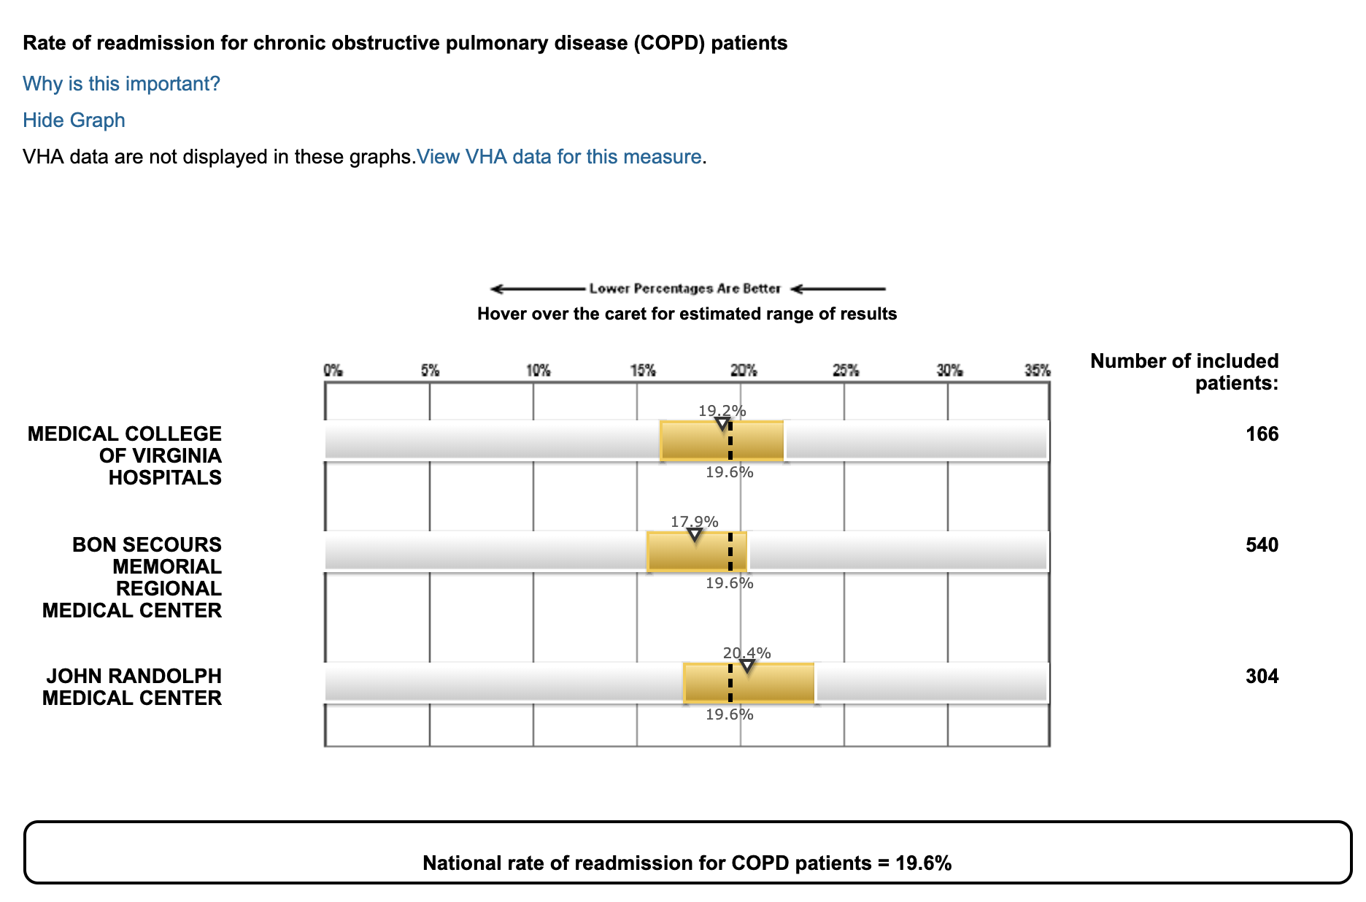
Using CMS Hospital Compare: COPD Readmissions
Source: http://www.medicare.gov/hospitalcompare, accessed April 8, 2019.
Notes:
COPD measures are coming this December – another critically important target population.

Slide 41
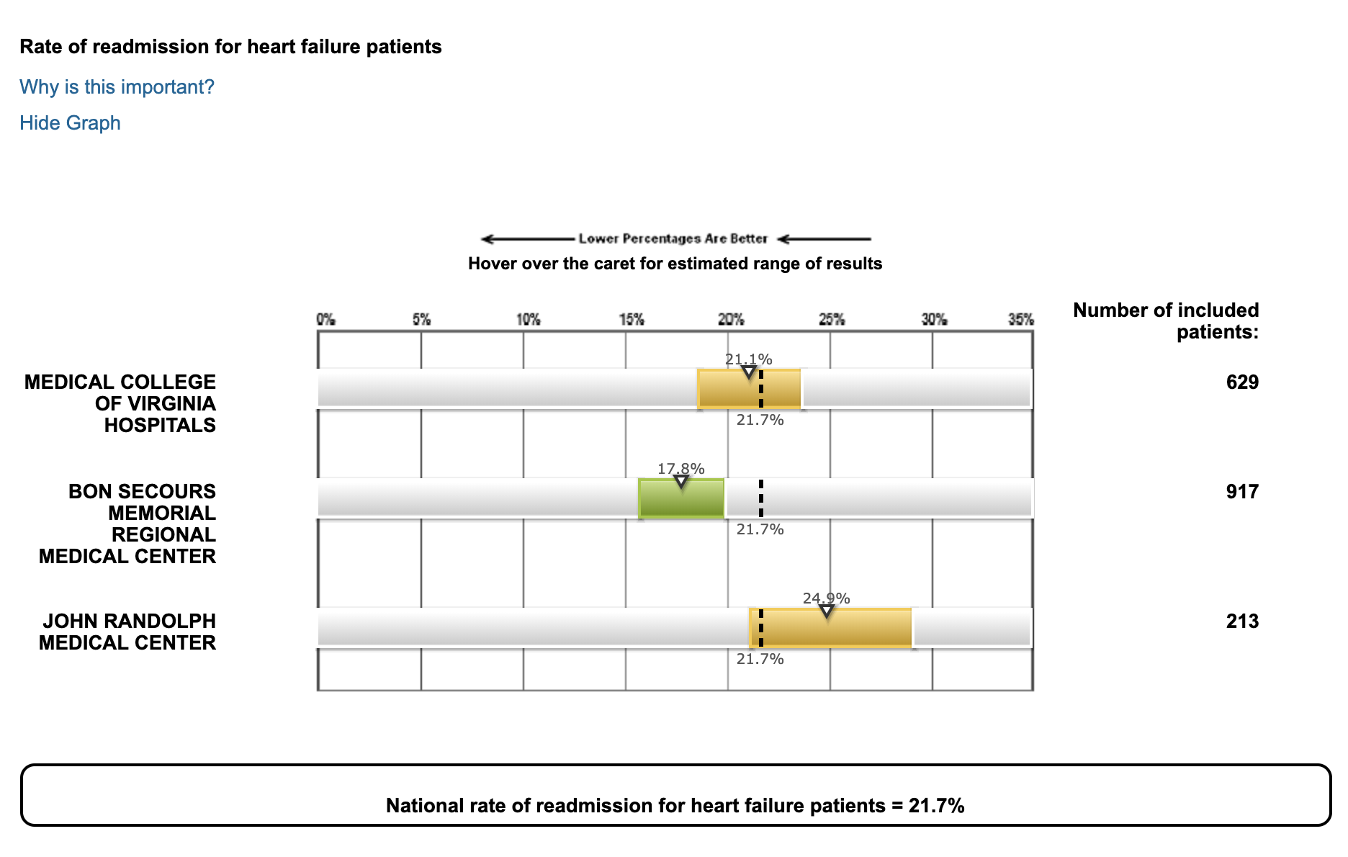
Using CMS Hospital Compare: CHF Readmissions
Source: http://www.medicare.gov/hospitalcompare, accessed April 8, 2019.
Notes:
COPD measures are coming this December – another critically important target population.

Slide 42
These Lessons Apply for More than ACOs
Source: David Muhlesten, et al., “Recent Progress in the Value Journey: Growth of ACOs and Value-Based Payment Models in 2018,” Health Affairs Blog, August 14, 2018.

Slide 43
Strategy Case Study: AccentCare

Slide 44
AccentCare Acquires Steward Home Care and Hospice in December 2018
AccentCare is a Dallas-based post-acute care company
Acquired Steward Home Care and Hospice December 31,2018
Steward Home Care and Hospice operates in Massachusetts and New Hampshire
Previously the Hospice was owned by Steward Health Care, affiliated with one of the nation’s 51 Next Generation ACOs
Acquisition gives AccentCare a chance to gain a new market with instant affiliation with an at-risk ACO

Slide 45
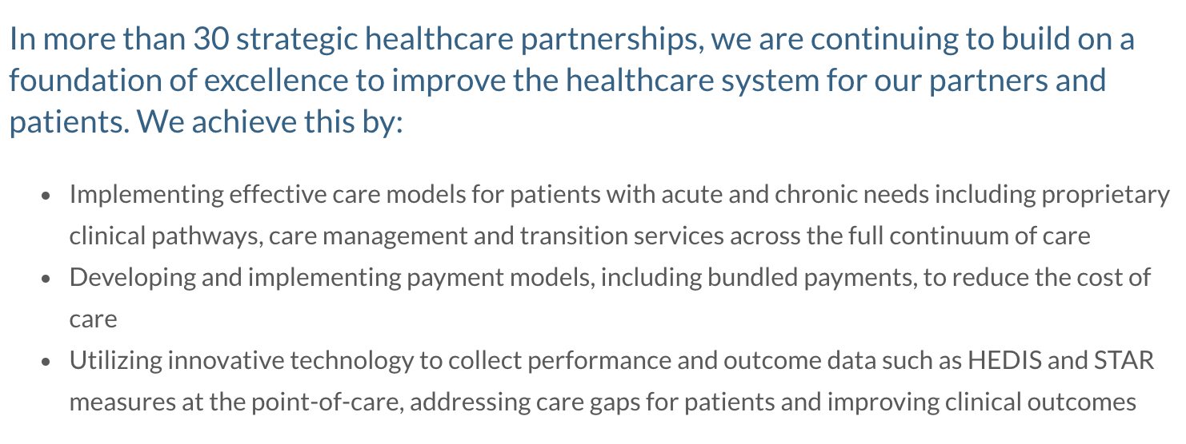
AccentCare’s Website Touts Partnerships and Innovation
From AccentCare’s Website:

Slide 46
Nine Next Gen ACOs Are Already in Massachusetts Accepting Downside Risk under that Advanced Model
Source: Center for Medicare and Medicaid Services, https://innovation.cms.gov/initiatives/next-generation-aco-model/, accessed April 8, 2019.

Slide 47
ACO Strategy a Key Reason for the Deal
“One of the other most attractive things about the Steward deal is that they run one of the largest ACOs in the country. As part of the deal with Steward, we’re actually contracted into their ACO in the Massachusetts marketplace– and will be moving into more shared-risk arrangements with them around their ACO within the first year.”
Steve Rodgers
AccentCare CEO
Source: Robert Holly, “AccentCare Lands ACO Relationship with Latest Acquisition,” Home Healthcare News, January 7, 2019.

Slide 48
Healthcare’s New Mantra
The right care, in the right place, at the right time.

Slide 49
Slides and Report Prepared by Sue Lyn Schramm Principal Schramm Consulting, LLC Aldie, Virginia 703-533-0416 sschramm@schrammconsulting.com www.schrammconsulting.com

